Slide 1
Research Methodology
Dr. Steven Cheah
Dr. Emily Tan
Dr. Neville Hewage

Slide 2
Research Foundation
Research Problems
Research Questions
Research Design
Qualitative Research
Quantitative Research
Mixed Methods Integration
Ethics and Governance
Data Analysis Techniques
Reporting and Dissemination

Slide 3
Research Foundations
✅ What academic research really is
✅ The role of literature review and how to conduct one
✅ The difference between qualitative and quantitative research
✅ How to formulate a strong research question
✅ How to select the right methodology
✅ Common mistakes to avoid when starting your research
✅ Tools and resources for beginner researchers

Slide 4
Research Problem WHAT & WHY
What is the exact issue/topic
Why study it - Justification
What are the specific goals & aims of the study
What is already known about it
What is the research gap
Example: Addiction to Social Media
Remote work and employee productivity

Slide 5
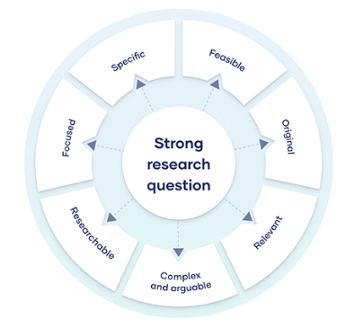
Research
Questions
How does social media use affect self-esteem in teenagers aged 13–18?

Slide 6
Research Design: Types of Research
Descriptive – describes a population/phenomenon
Exploratory – looks at problems in early stages of study
Explanatory
  Correlational – associated changes in 2 or more variables
  Causal – how 1 variable causes changes in another
Experimental – manipulate variables to observe cause-effect relationships
Case study – in-depth investigation of single subject/group/event explore complex phenomena within its real-world context

Slide 7
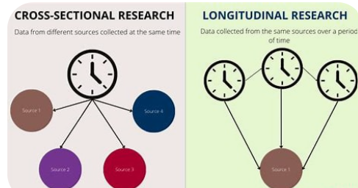
Research Design: Time Frame of Research

